Slide 1


Batch details | DSE-FT-C-MAY22-G2
Team members | Akshay Jadhav Arun Cibi Chellasamy Varshiney M Sabarivasan R
Domain of Project | HealthCare & Pharma
Proposed project title | Prediction of Diabetes using Classification Models
Group Number | GROUP 2
Team Leader | Sabarivasan R
Mentor Name | Mr. Pratik Sonar

Slide 2
BUSINESS PROBLEM UNDERSTANDING
The Goal is to predict the diabetes risk of a person from the data collected via simple survey questions will result in early diagnosis which can lead to lifestyle changes and more effective treatment, making predictive models for diabetes risk an important tools for public and public health officials. Medical Insurance and Fitness company can make a targeted sale on the population.
Problem Statement
The CDC estimates that 1 in 5 diabetics, and roughly 8 in 10 pre diabetics are unaware of their risk. While there are different types of diabetes, type II diabetes is the most common form and its prevalence varies by age, education, income, Blood Pressure, Cholesterol and other social determinants of health.

Slide 3
Attributes Used
DATA SET INFORMATION
Data Size
Target Variable
Data Collection
253680 -22
Healthy - 0
Diabetic -1
kaggle.com
High BP
HighChol
CholCheck
BMI
Smoker
Stroke
HeartDiseaseAttack
PhysActivity
Fruits
Veggies
HvyAlcoholConsump
AnyHealthcare
NoDocbcCost
GenHlth
MentHlth
PhysHlth
DiffWalk
Sex
Age
Income
Education

Slide 4
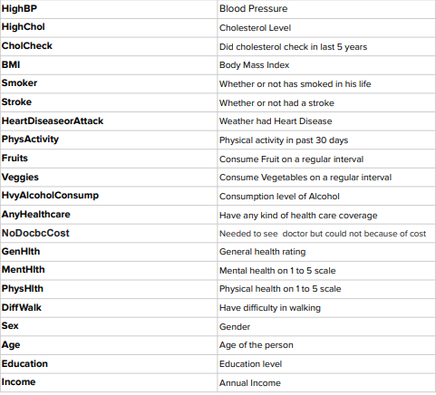
Data Dictionary

Slide 5
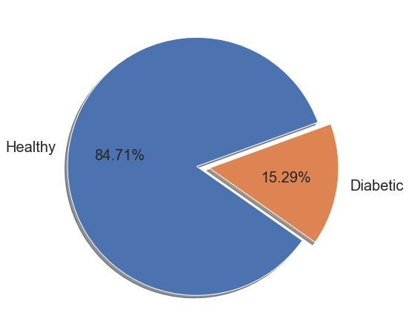
Univariate Feature Selection
Exploratory Data Analysis
Proportion of Target Variable
Out of the total population, 84.71% of data points are of the Healthy class whereas only 15.29% of data points belong to the class of interest Diabetic.

Slide 6
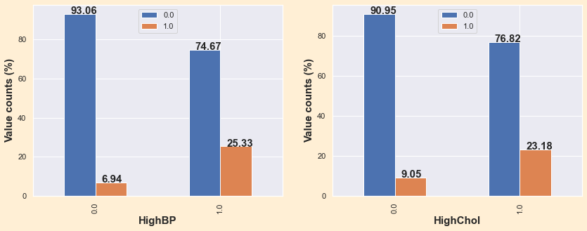
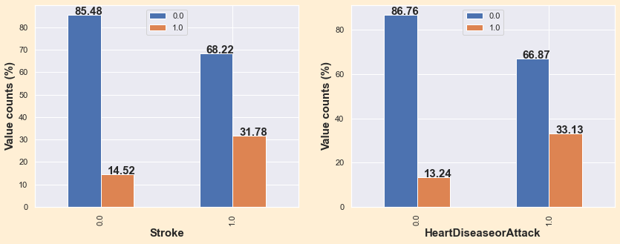
Individuals with High Cholesterol, High Blood Pressure, Heart Attack & Stroke are at a high risk of Diabetes compared to the individuals with low respective values.

Slide 7
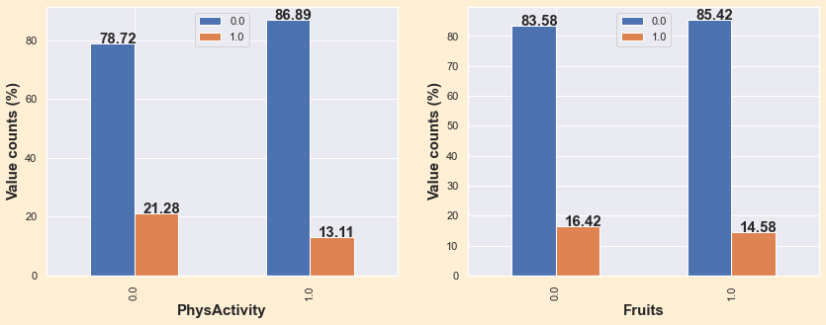
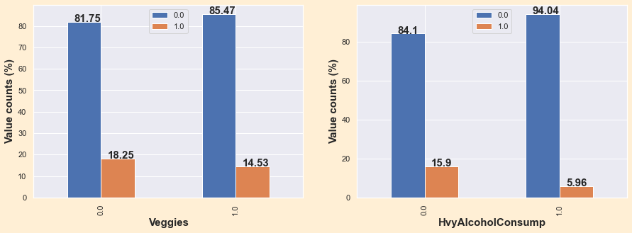
Diabetes has less attentiveness to the individuals who are consuming Fruits, vegetables & being Heavy Alcohol consumer, Physically active than the individuals which are not belongs to this group

Slide 8
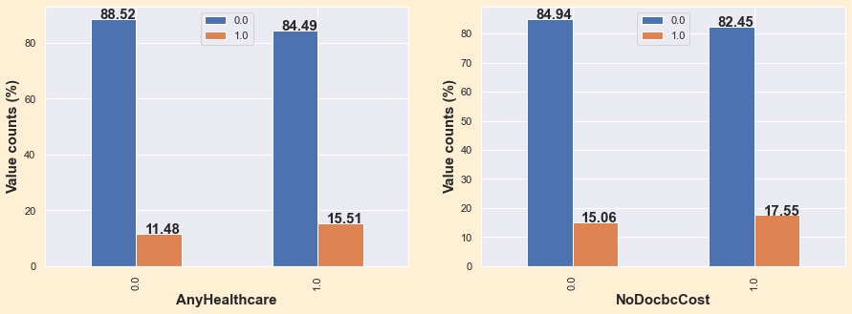
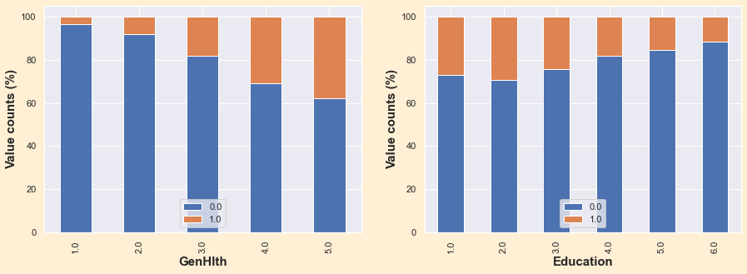
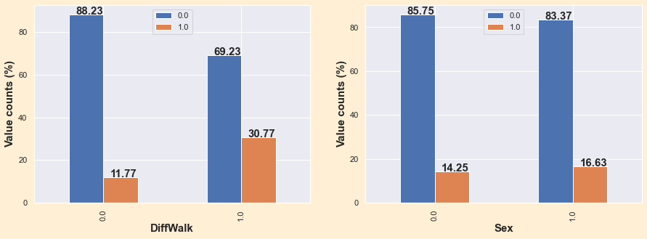
Data represents individuals with Healthcare and medical insurance aware to the diabetes in contrast to an individual not having the same

Slide 9
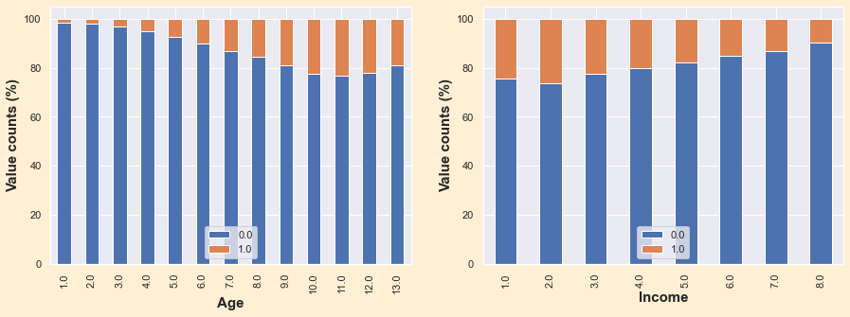
Though there is no disparity in people of different gender, diabetes is more in people of lower income groups, elderly people and people who

Slide 10
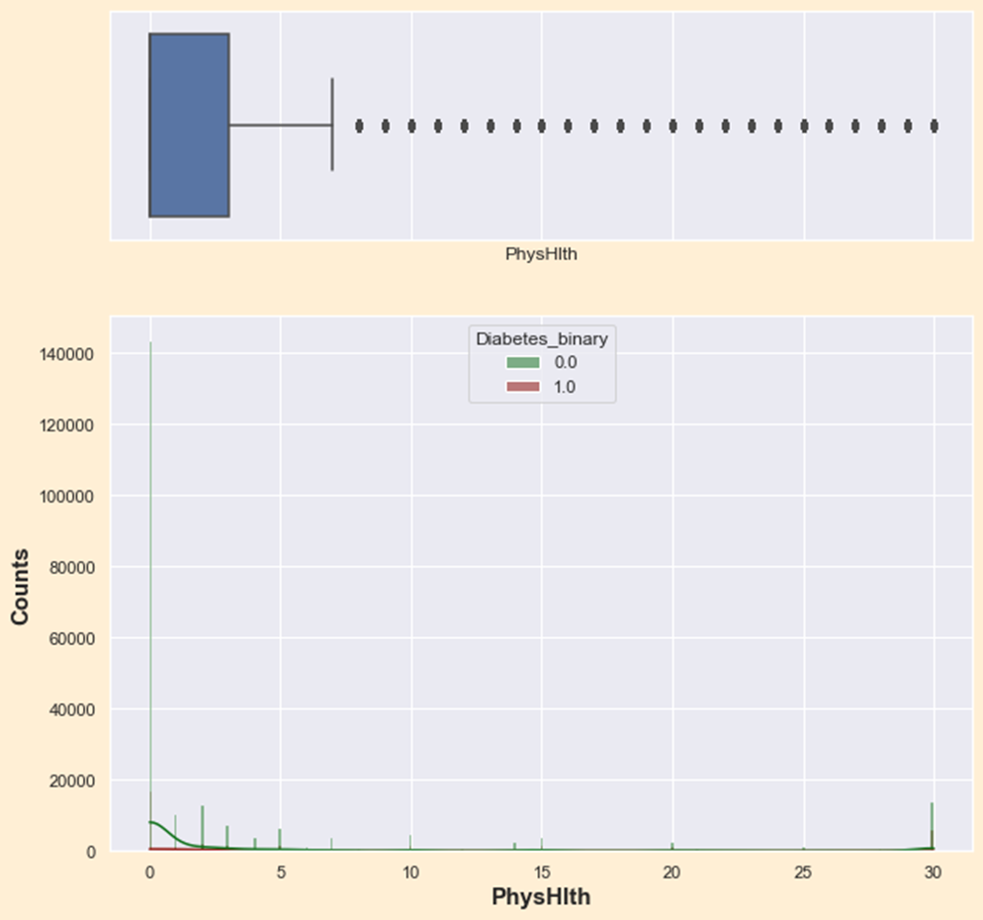
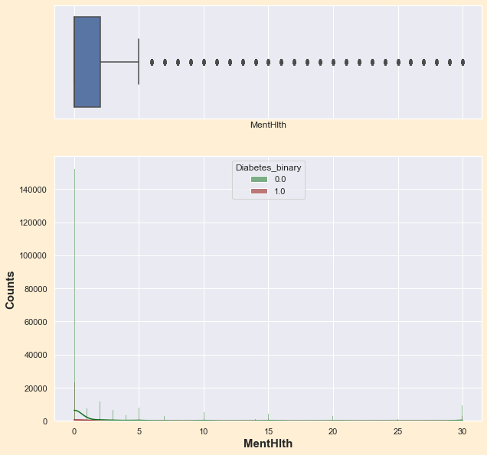
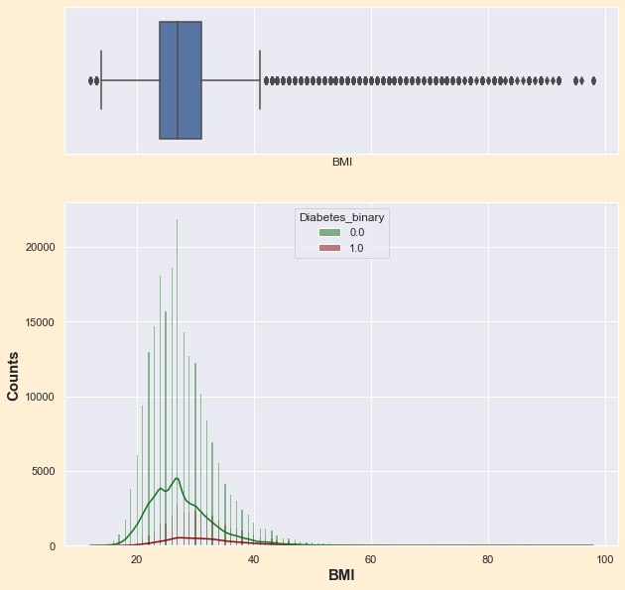
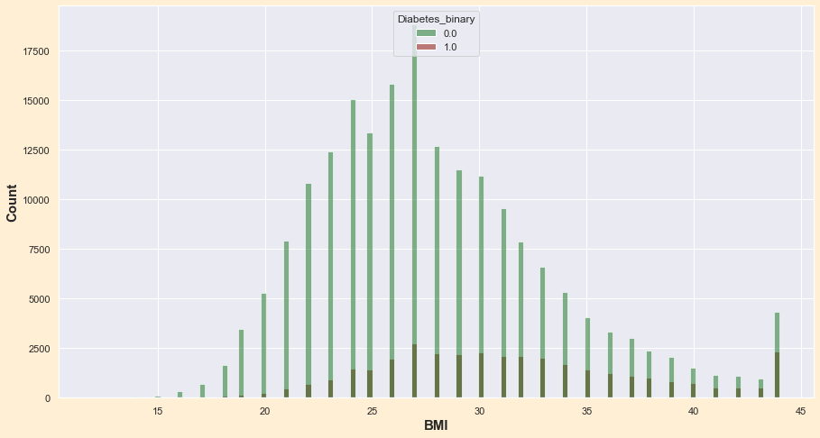
Distribution of BMI, Physical & Mental Health Features
Both the Mental health and Physical health columns seem to have outliers but we have found it to be a pattern.
In the BMI column there were few values which were scientifically impossible to happen. Hence they are treated.

Slide 11
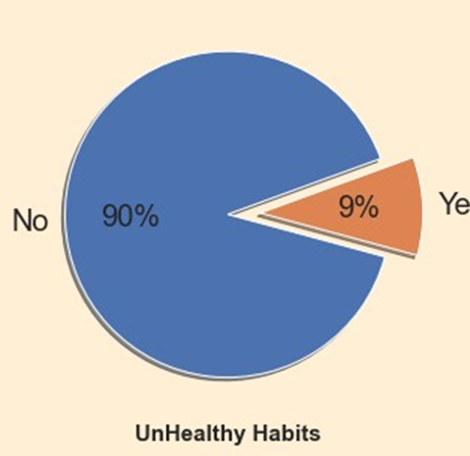
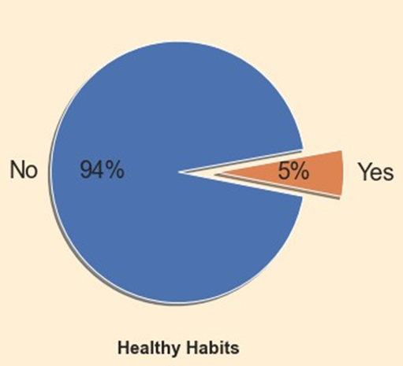
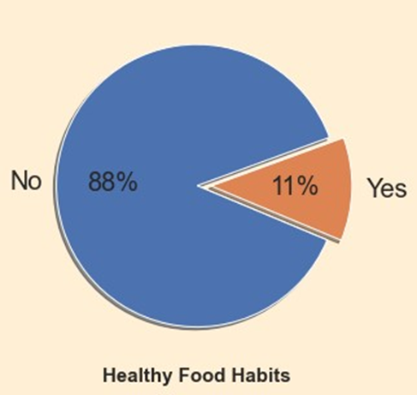
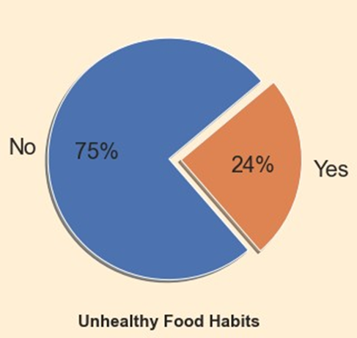
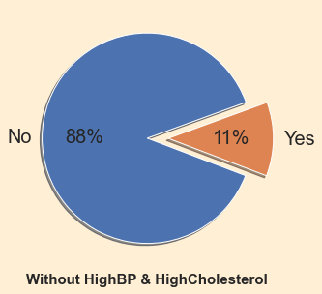
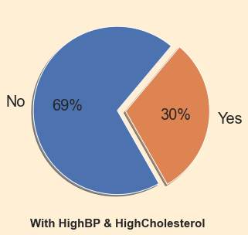
People who don’t do any physical activity, have the habit of drinking and smoking
Physical health ailments within 7 days who consumes fruits and vegetables
People who have high BP and high cholesterol

Slide 12
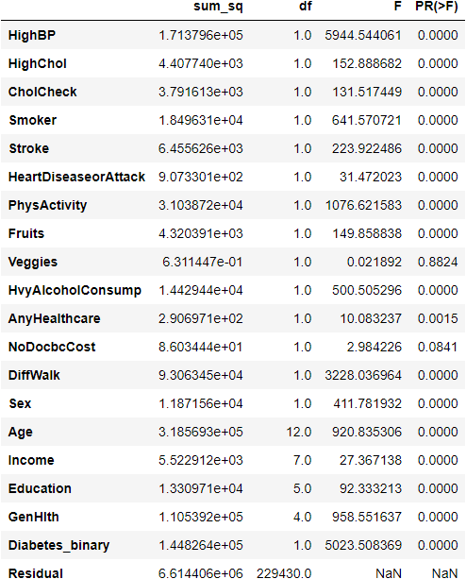
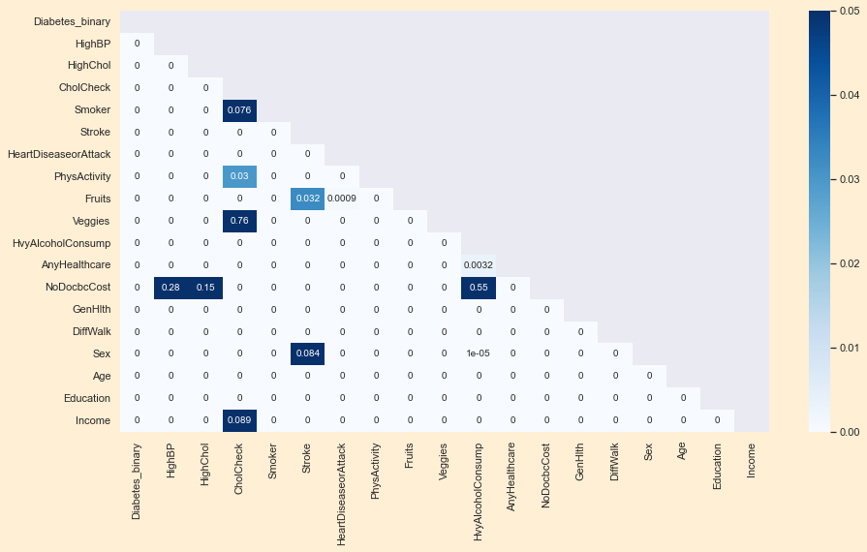
Statistical Tests
Anova Test & Chi2 P_Value

Slide 13
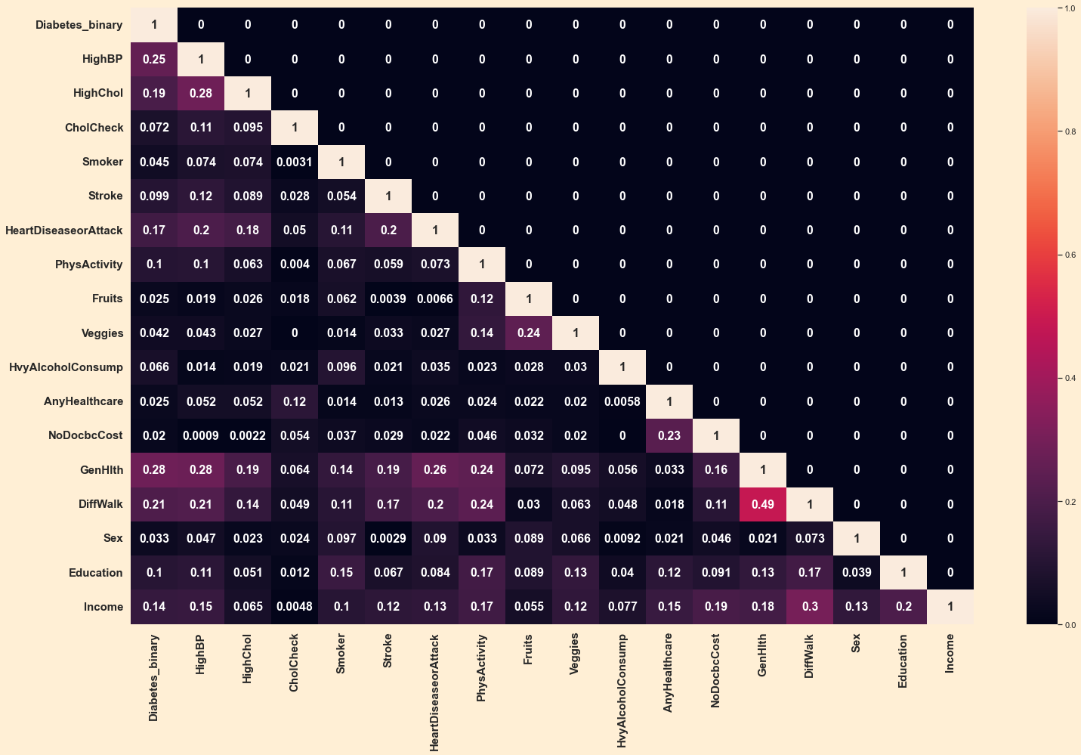
Cramer’s V Score of Categorical Features
There is moderate Positive Association between Difficulty to Walk and General Health.
Target Variable have high Association with GenHlth, Blood Pressure, High Cholesterol using Cramer’s V score

Slide 14
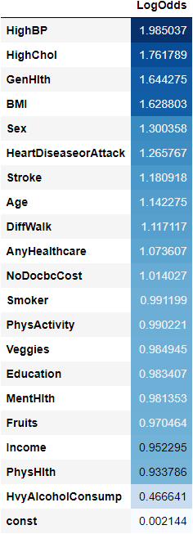
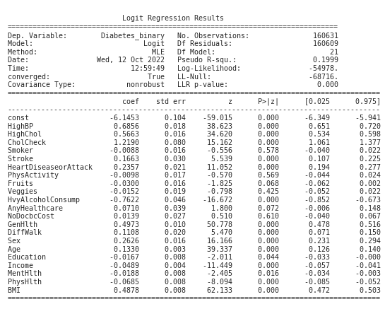
BASE MODEL
From the model summary we can see that the Pseudo R² value is fairly low but the LLR- P Value is very low at 0.00
With the summary and odds ratio of the Logistic Classification Base Model we can see that the HighBP variable is highly contributing to the target variable, i.e if You have BP it increases the probability of having Diabetes by 1.98 times.
Followed by HighChol showing Probability of having Diabetes is 1.76 times high if an Individual have high cholesterol

Slide 15
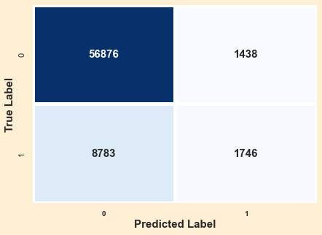
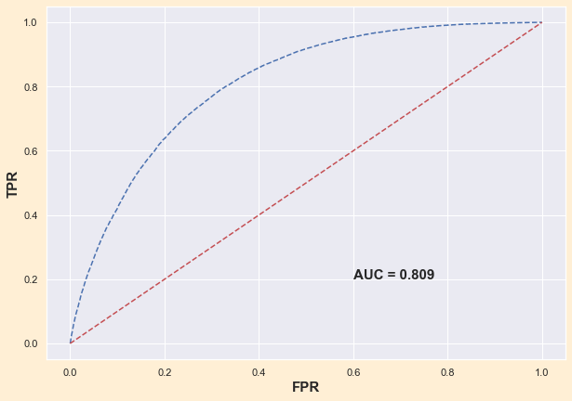
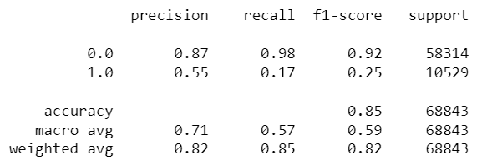

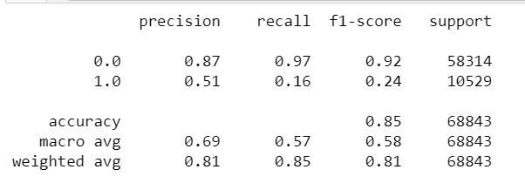
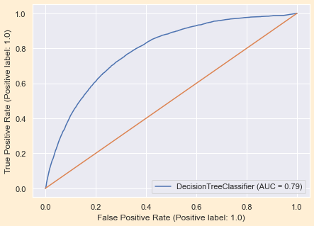
Logistic Regression Base Model
Decision Tree Base Model

Slide 16
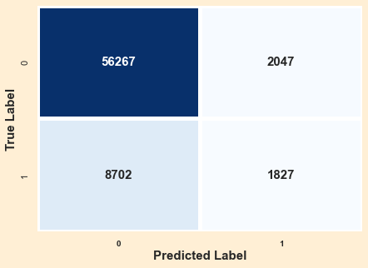
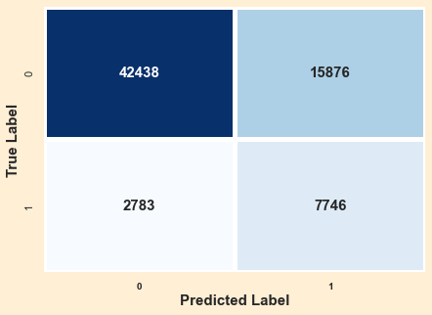
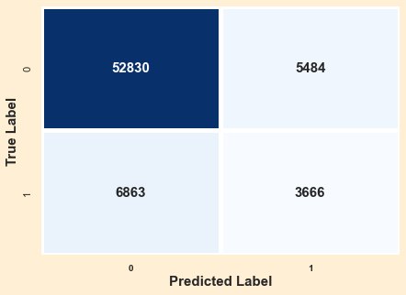
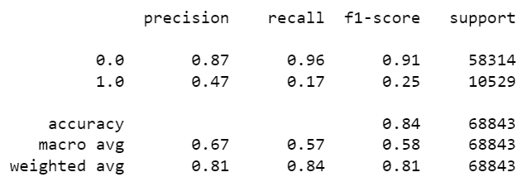
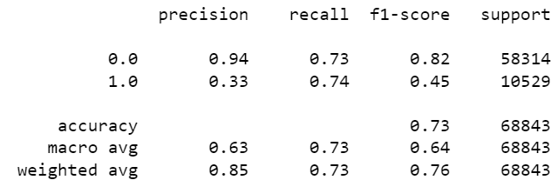
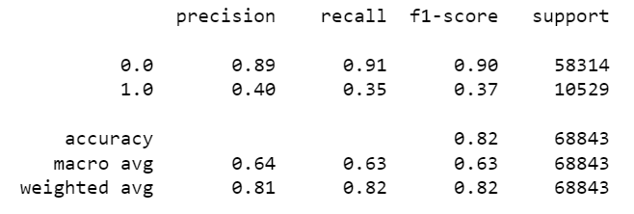
Random Forest
Random Forest (Tuned)
Bernoulli Naive Bayes

Slide 17
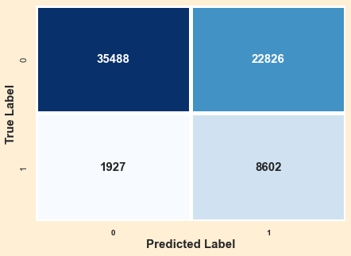
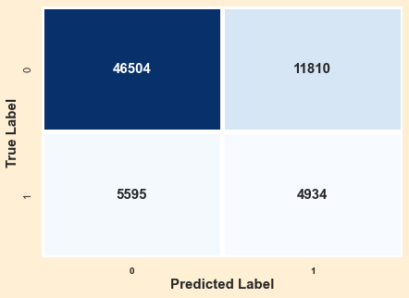
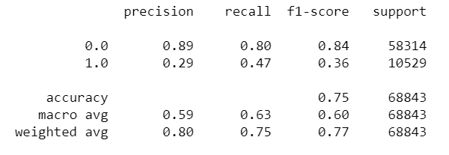
Sampling of Data using SMOTEN
Random Forest on SMOTE Data
XGBoost on SMOTE Data

Slide 18


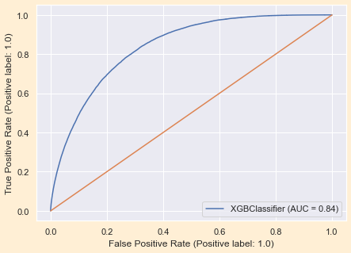
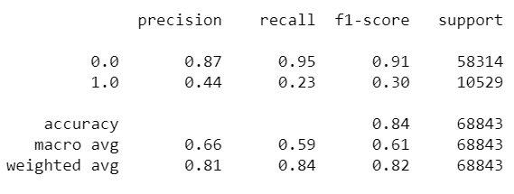
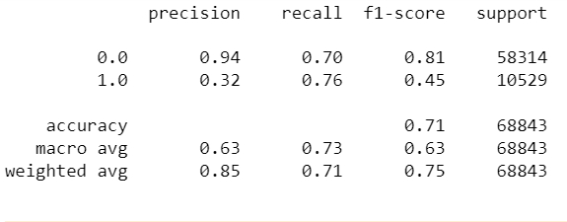
Boosting Models
XGBoost
Tuned XGBoost

Slide 19

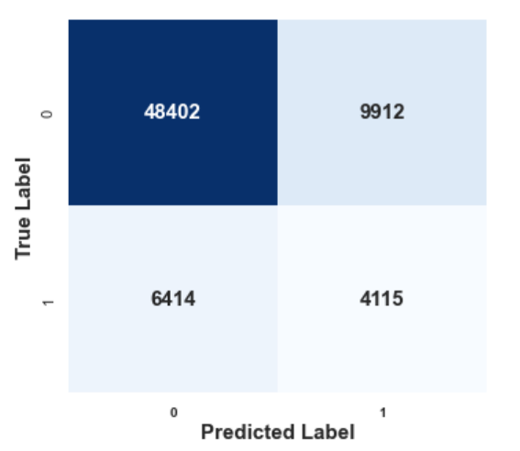
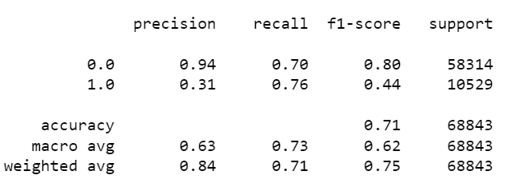
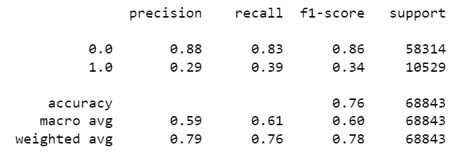
Stacked Models
Base Estimators : DecisionTreeClassifier, RandomForestClassifier, BernoulliNB, XGBClassifier
Final Estimators : DecisionTreeClassifier
Stacked Model
Stacked Model in SMOTE Data

Slide 20
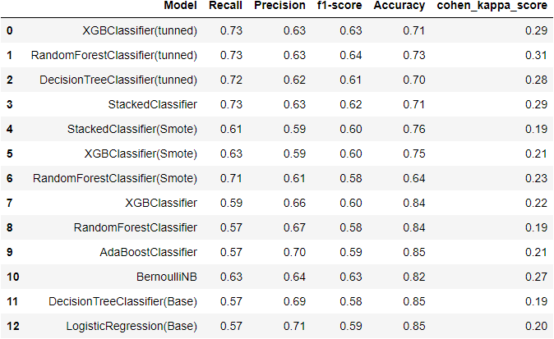
ML model Result Comparison
Inference
The Logistic Regression model is our base model.
The LR model and the DT model yields the least scores compared to all the other models.
The XGBoost & Random forest model (Tunned) have the maximum Accuracy, Precision, Recall, Kappa, F1 scores.

Slide 21
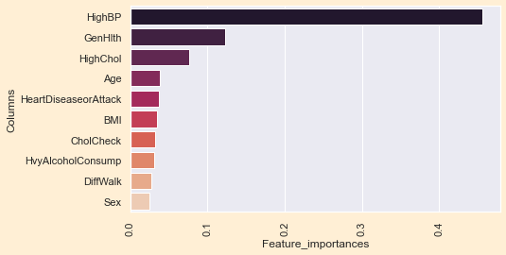
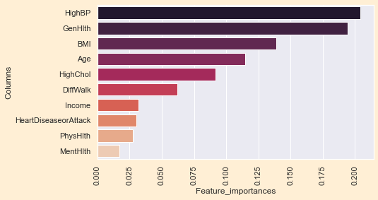
Business Interpretations
1.people with high BP and high cholesterol are at high risk of diabetes
2. Self awareness of general health plays important role
3.BMI and Age
After reaching a certain age, people must be physically active to tap in their blood glucose which will also help in maintaining the BMI

